Slide 1
Sales Analysis
Analysis by Harsh Agrawal

Slide 2
Company sales by each Quarter of a year

Slide 3
Company Year Over Year Sales Growth
There is a steep dive in sales in 2022

Slide 4
Product Category Wise Sales
Category wise Sales
Per year sales of each category

Slide 5
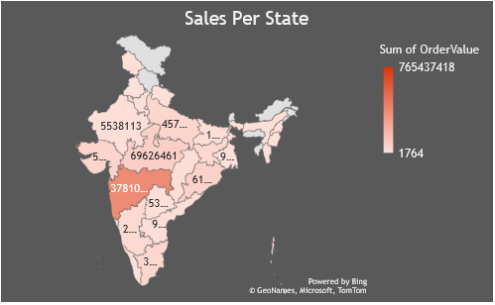
Top 10 Cities and sales per sate wise
Count of customers
Sales per state

Slide 6
Sales per category by each Year

Slide 7
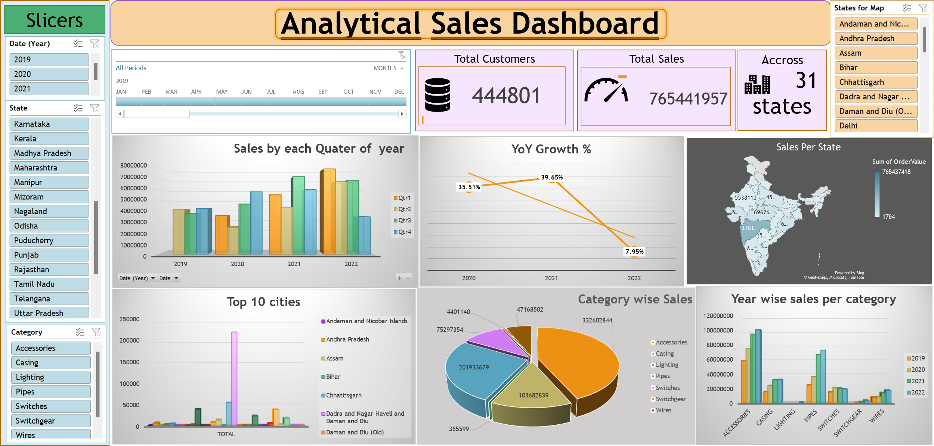
Use Excel dashboard workbook to get the result follow this link DA Test Data.xlsx

Slide 8
Q1. In which state maximum sales happen?
Ans:- Maharastra
Q2. In which state minimum sales happen?
Ans:- Mizoram
Q3. Which product category has Higher Demand?
Ans:- Accessories
Q4:- Which Products has very less demands?
Ans:- Lightings
Q5:- How many of customer purchased the products overall?
Ans:- 4447
Q5:- Which Year had highest Sales?
Ans:- 2022
Q6. In which year maximum Growth happen?
An:- 2021
Q7. Which product has minumum sales?
Ans:- SwitchGear

Slide 9


How to Improve Sales
As we can see through the data that in Mizoram only 3 customers purchased a product of rs.1764.
Total Customers
Total Sales in Rs
Population of Mizoram 11Lakh
Company Can increase their Marketing Spend in Mizoram to get more sales if we assume that company is not spending any rupee in Mizoram for advertising their products.
If company want to advertise digitally through Instagram and facebook:-
Age wise distribution
Age:- 0-15 15-30 30-45 45-60 60+
Dist:-2.25L 2.25L 2.25L 2.25L 2.25L
%using social media
10% 90% 70% 10% 5%

Slide 10
Total population using Instagram:- 6Lack (Approx.)
If a single ad costs 2rs then 2x6Lack = 12Lack
So total advertisement would be co around 12 lack ruppee
If the retention rate will be 10% then approx. 60,000 customers will be reatained.
Links to go to excel file for reference DA Test Data.xlsx

